Slide 1
DATA STRUCTURE

Slide 2
Introduction to Data Structures:
Data structure is a representation of logical relationship existing between individual elements of data.
In other words, a data structure defines a way of organizing all data items that considers not only the elements stored but also their relationship to each other.
The term data structure is used to describe the way data is stored.

Slide 3
To develop a program of an algorithm we should select an appropriate data structure for that algorithm. Therefore, data structure is represented as:
Algorithm + Data structure = Program

Slide 4
A data structure is said to be linear if its elements form a sequence or a linear list.
The linear data structures like an array, stacks, queues and linked lists organize data in linear order.
A data structure is said to be non linear if its elements form a hierarchical classification where, data items appear at various levels

Slide 5
Trees and Graphs are widely used non-linear data structures.
Tree and graph structures represents hierarchial relationship between individual data elements.
Graphs are nothing but trees with certain restrictions removed.

Slide 6
Data structures are divided into two types:
• Primitive data structures.
• Non-primitive data structures.

Slide 7
Primitive data structures.
the basic data structures that directly operate upon the machine instructions.
They have different representations on different computers.
Integers, floating point numbers, character constants, string constants and pointers come under this category.

Slide 8
Non-primitive data structures.
more complicated data structures and are derived from primitive data structures.
They emphasize on grouping same or different data items with relationship between each data item.
Arrays, lists and files come under this category.

Slide 9
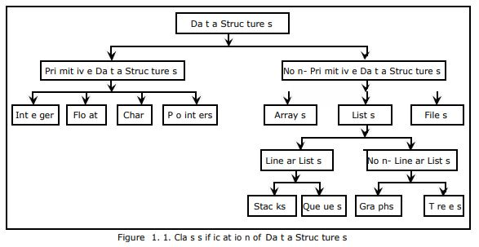
Figure 1.1 shows the classification of data structures.

Slide 10
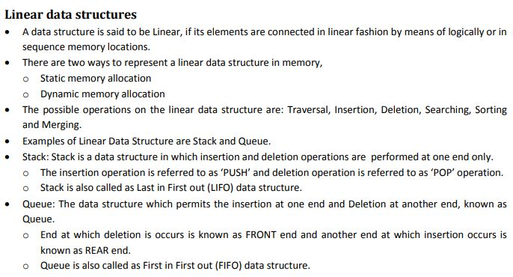

Slide 11
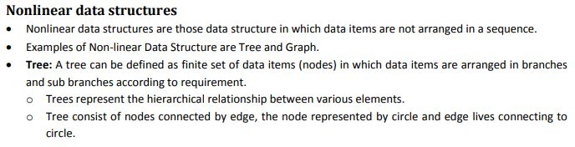

Slide 12
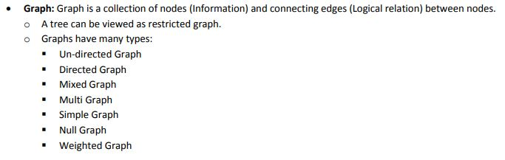

Slide 13
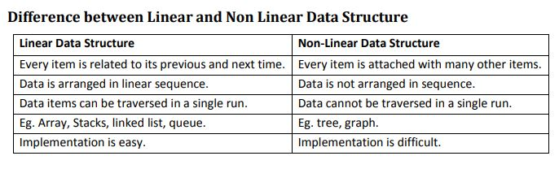

Slide 14
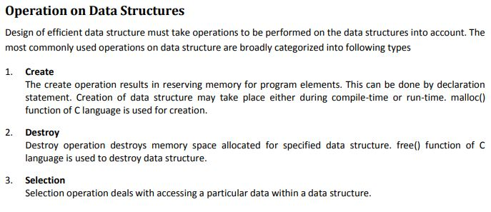

Slide 15
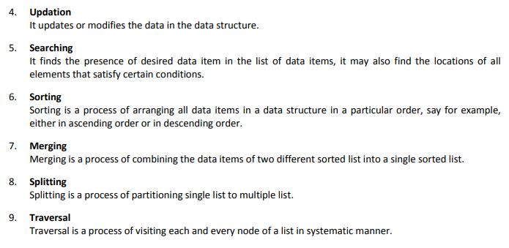

Slide 16
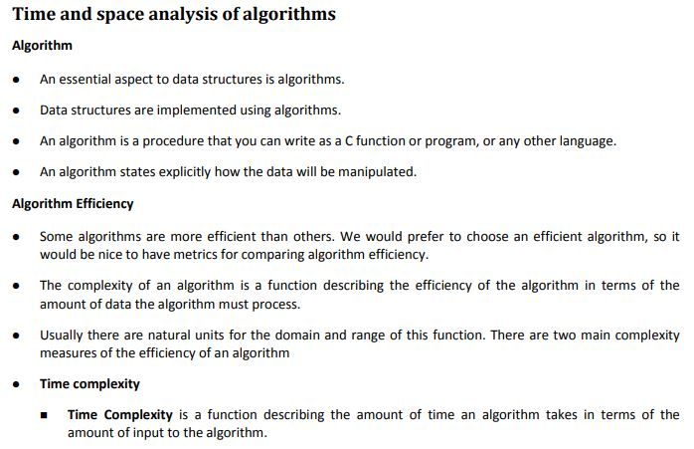

Slide 17
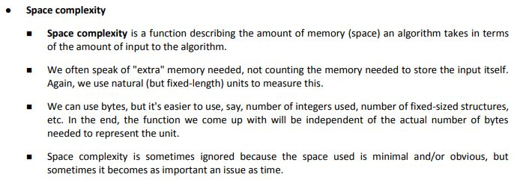

Slide 18
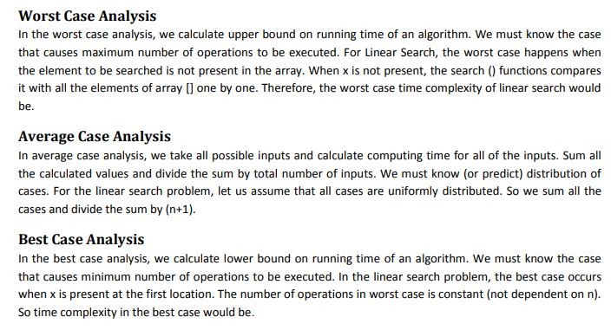

Slide 19
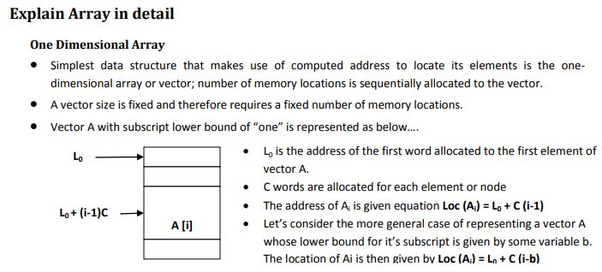

Slide 20
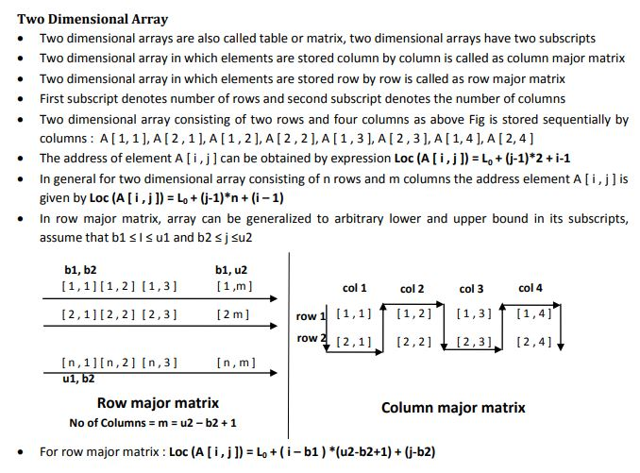

Slide 21


Slide 22
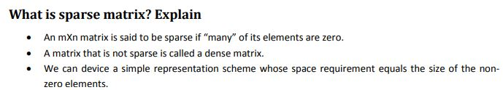

Slide 23
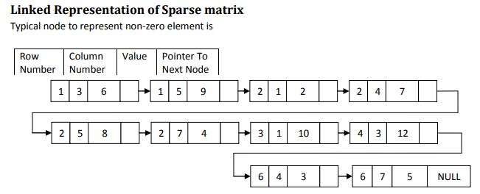

Slide 24
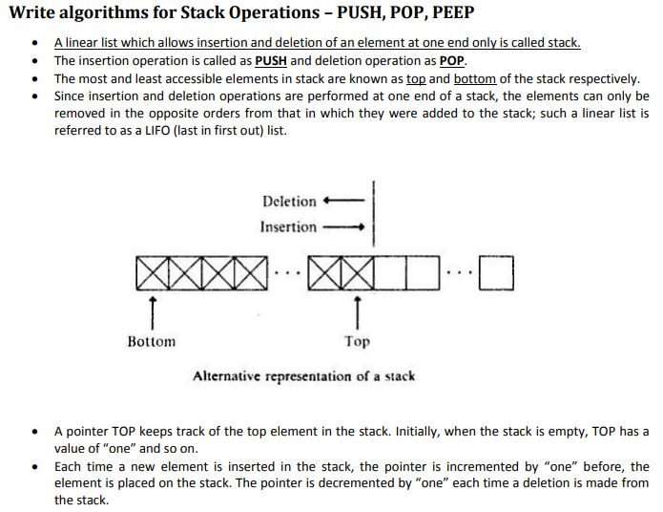

Slide 25
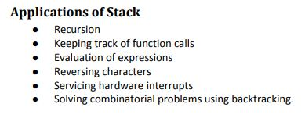

Slide 26
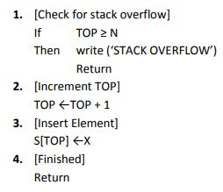
Procedure: PUSH(S,TOP,X)

Slide 27
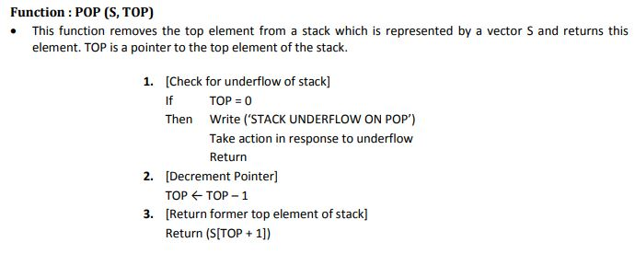

Slide 28
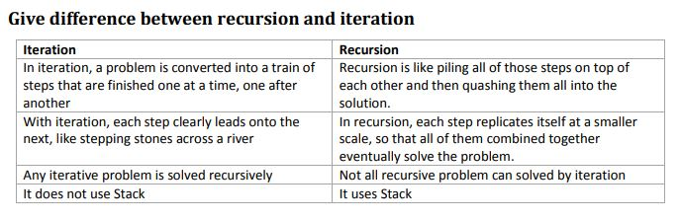

Slide 29
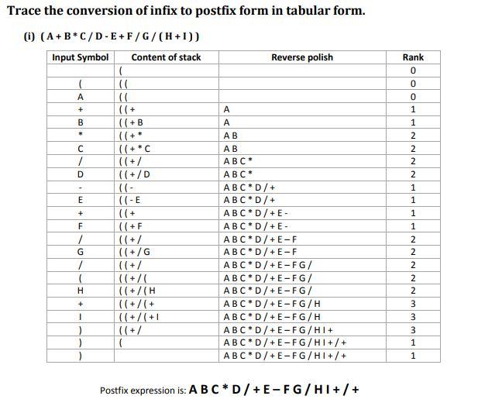

Slide 30
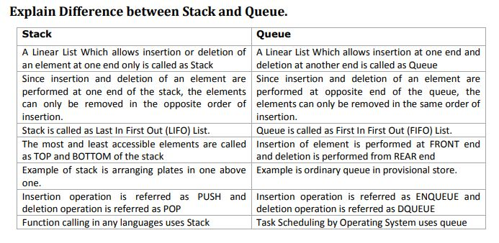

Slide 31
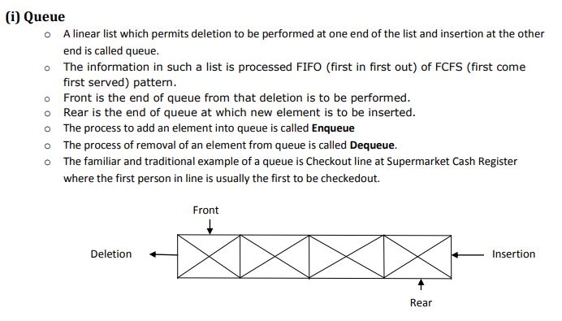

Slide 32
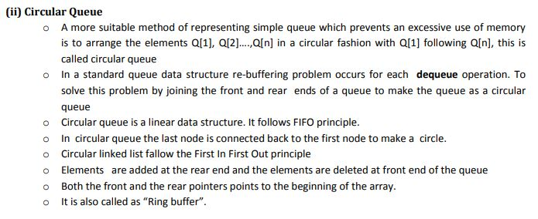

Slide 33
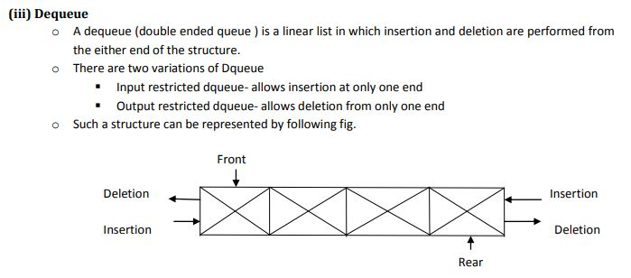

Slide 34
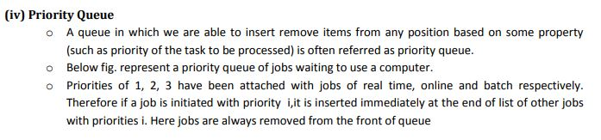

Slide 35
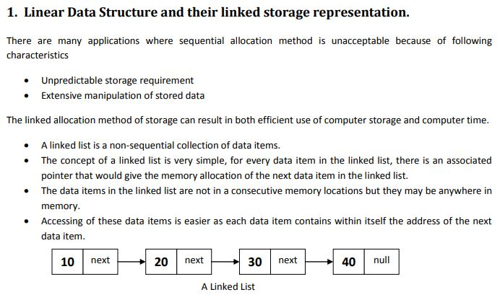

Slide 36
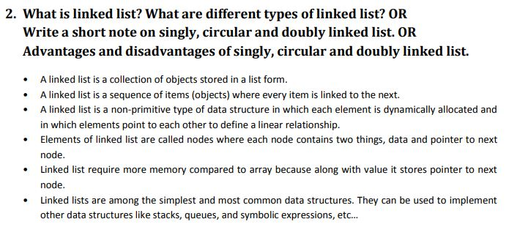

Slide 37
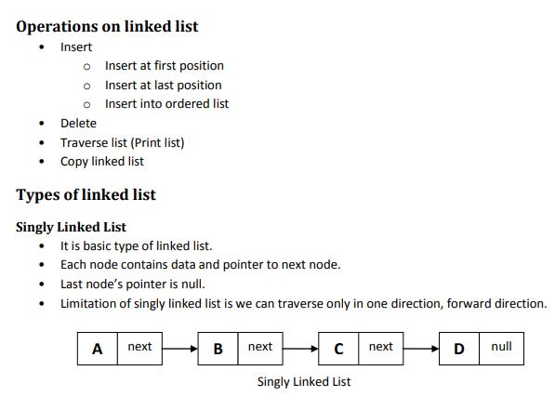

Slide 38
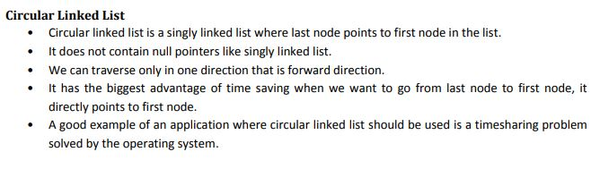

Slide 39
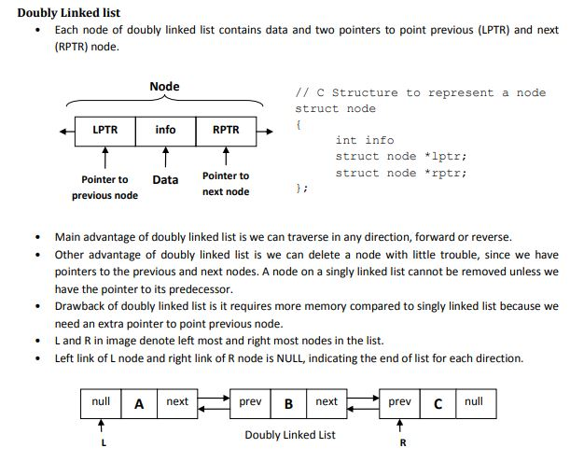

Slide 40
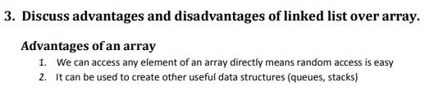

Slide 41
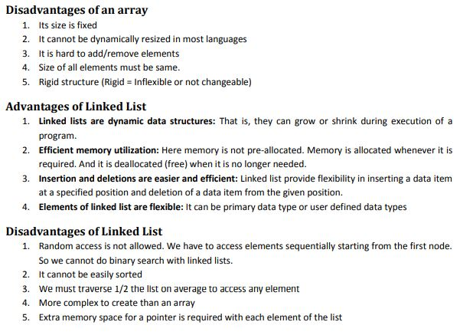

Slide 42
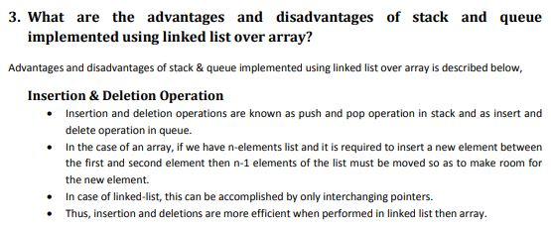

Slide 43
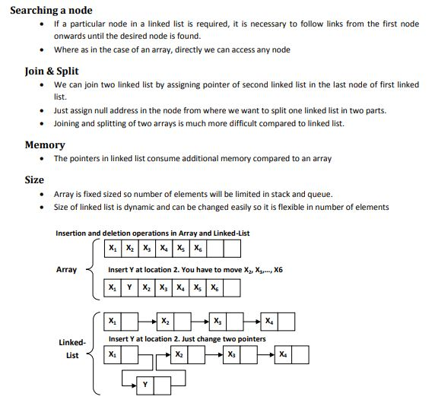

Slide 44
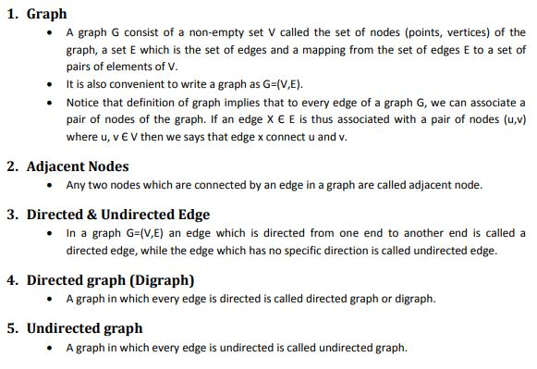
Non-linear Data Structure(graph&tree)

Slide 45
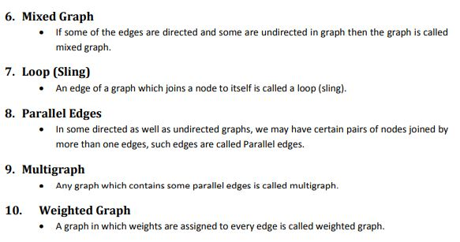

Slide 46
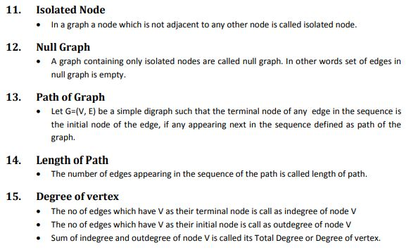

Slide 47
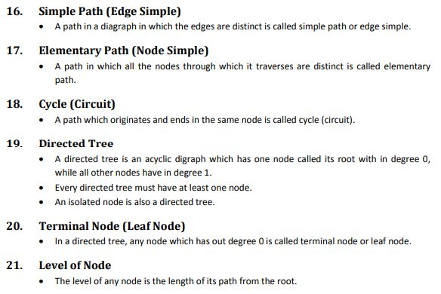

Slide 48
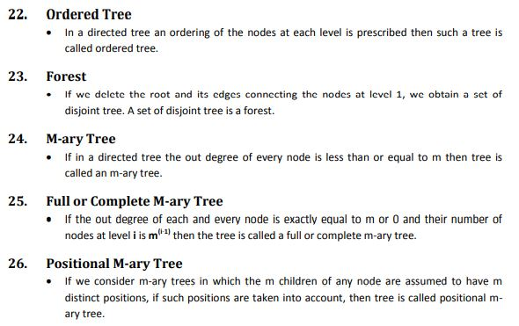

Slide 49
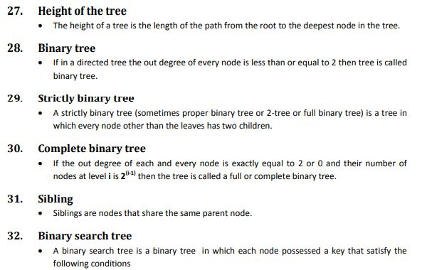

Slide 50
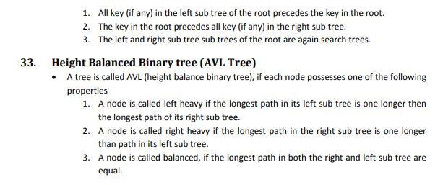

Slide 51
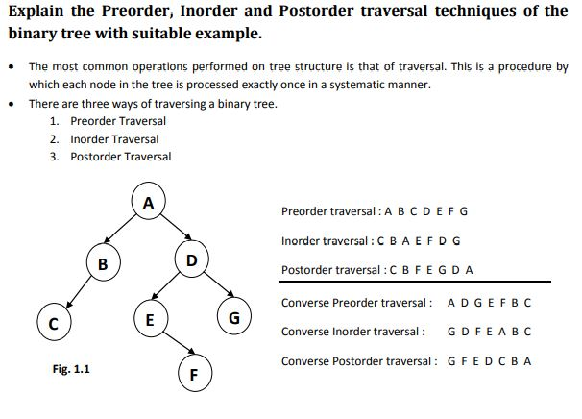

Slide 52
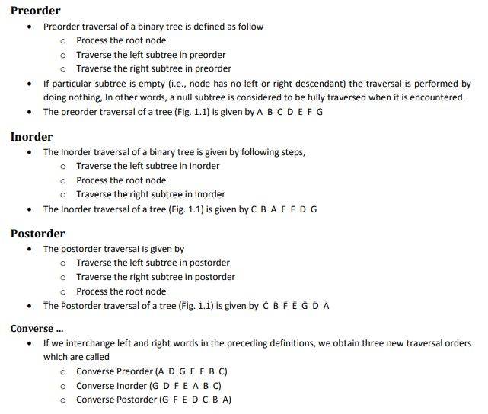

Slide 53
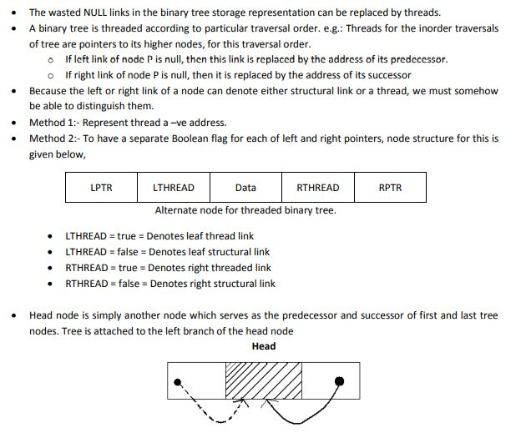
Threaded Binary Tree

Slide 54
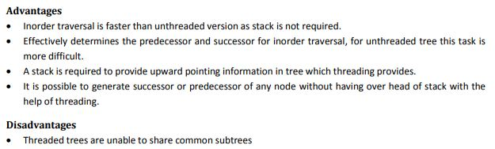

Slide 55
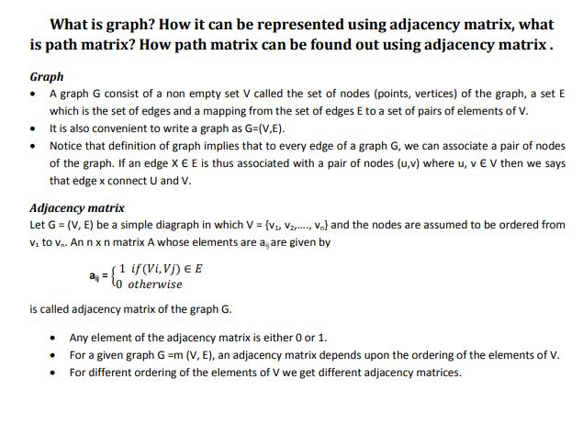

Slide 56
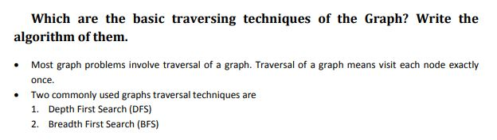

Slide 57
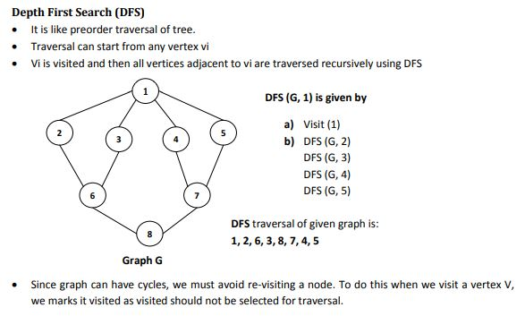

Slide 58
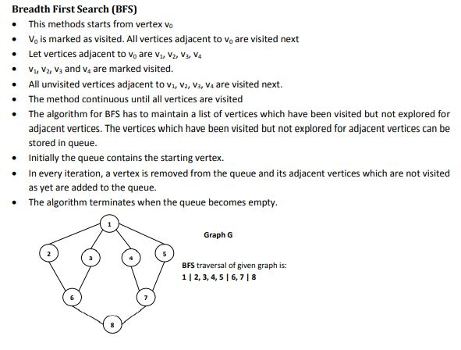

Slide 59
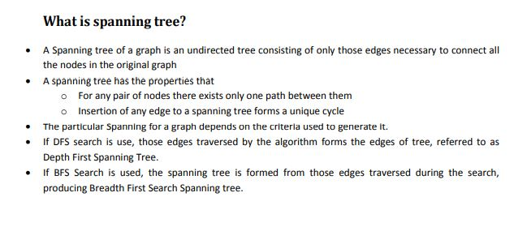

Slide 60


Slide 61


